Slide 1


Advanced Programming Techniques CS-307
Graphics Device Interface(GDI), Painting & Drawing in C#
Instructor：Muhammad Rauf Sarwer
Notes:
Today we will start learning how to create graphics in C#. This is where programming becomes more visual and interactive. We’ll use Windows’ built-in Graphics Device Interface (GDI) to draw shapes, text, and even respond to user actions like mouse clicks.

Slide 2

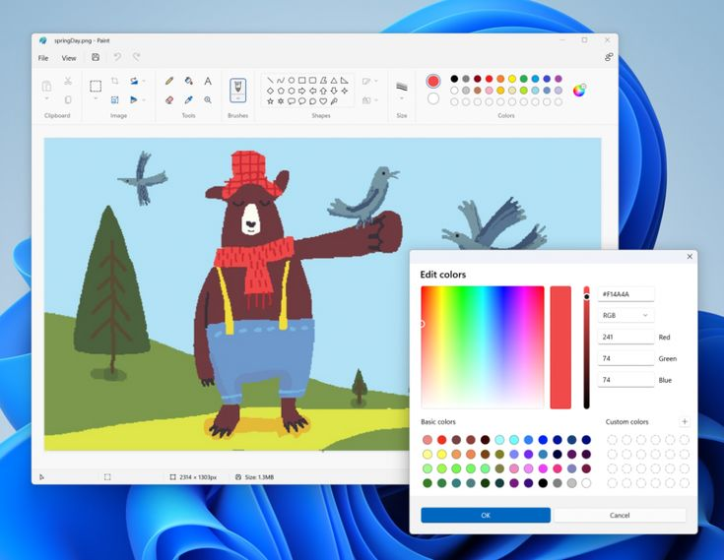

What is GDI?
Way to work with painting graphic objects such as painting on windows, form, etc.
  A Windows component for 2D graphics
  Provides tools to draw shapes, text, and images
  Used in Windows Forms applications
  Works independently of hardware → same code works for screen, printer, or file
  In C#, GDI is accessed through the Graphics class
在此输入详细内容，建议：文字言简意赅，分点阐述核心观点；可适当调整字体、颜色、行间距等格式以突出重点
Notes:
GDI stands for Graphics Device Interface. Think of it as the artist inside Windows that handles all drawing.
Whenever you see text, icons, or images in a Windows app, GDI is at work.
The great thing is that GDI works the same way no matter the device — whether drawing on your monitor, printing on paper, or saving to a file.
In C#, we work with the Graphics class to access GDI features.

Slide 3
The Graphics Object
The Graphics Object = Your Virtual Artist!
You (Programmer) → Give commands → Graphics Object (Artist) → Draws on Screen
Way to "Hire Your Artist":
  private void Form_Paint(object sender, PaintEventArgs e)
  {
  Graphics g = e.Graphics;
  g.DrawRectangle(pen, 10, 10, 100, 50);
  }

Slide 4
Your Drawing Coordinates
Coordinate System
  (0,0) = top-left corner
  X increases → right, Y increases → down
The Screen is Like a City Map:
  NORTH-WEST Corner
  ↓
  EAST
  House at (100,50)
  → 100 pixels RIGHT
  → 50 pixels DOWN
  SOUTH
(0,0)
(X)
increases
(Y)
increases
Notes:
Quick Coordinate Quiz:
Where is point (0,0)? → Top-left corner!
What does (200, 100) mean? → 200 right, 100 down!
What happens if Y increases? → We go downward!

Slide 5
Pens - Your Digital Outline Tools
Pens = For Drawing Lines and Borders
Meet Your Digital Pen:
// Basic Pen - Your Go-To Tool
Pen blackPen = new Pen(Color.Black, 3); // Color + Thickness
g.DrawEllipse(pen, 20, 20, 50, 50);

Slide 6
Brushes - Your Digital Fill Tools
Brushes = For Filling Shapes with Color & Texture
Your Brush:
// Solid Brush - One Color Fills All
Brush brush = new SolidBrush(Color.Green);
g.FillEllipse(brush, 20, 20, 50,50);

Slide 7
The Paint Event - Your Drawing Schedule
Paint Event Handler:
private void Form1_Paint(object sender, PaintEventArgs e)
{
Graphics g = e.Graphics; // Your artist arrives!
using (Pen pen = new Pen(Color.Black, 2))
using (Brush brush = new SolidBrush(Color.Blue))
{
g.DrawRectangle(pen, 10, 10, 100, 50); // Outline
g.FillEllipse(brush, 50, 50, 80, 80); // Fill
}
}

Slide 8
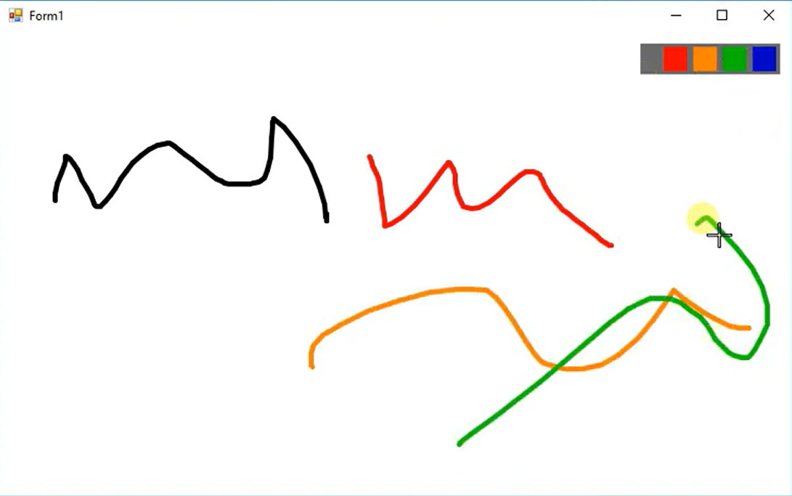
Building Our Paint App
Let's Create Our Own Microsoft Paint!
A drawing panel where you can paint with mouse
Color palette to choose different colors
Smooth, anti-aliased lines
Real-time drawing feedback

Slide 9
Hint
The Secret Sauce - Mouse Events:
MouseDown → "Start painting!"
MouseMove → "Keep painting while moving!"
MouseUp → "Stop painting!"

Slide 10
Paint App Code
The Coordinate Tracking System:
int x = -1, y = -1; // "Where did I start drawing?"
bool moving = false; // "Am I currently painting?"
Mouse Down - Start the Art:
private void panel_MouseDown(object sender, MouseEventArgs e)
{
moving = true; // "Yes, I'm painting now!"
x = e.X; y = e.Y; // "Remember where I started"
}

Slide 11
Paint App Code
Mouse Move - Create the Masterpiece:
private void panel_MouseMove(object sender, MouseEventArgs e)
{
if (moving && x != -1) // "If painting and have start point"
{
g.DrawLine(pen, x, y, e.X, e.Y); // Draw!
x = e.X; y = e.Y; // Update position
}
}
Mouse Up - Signature Complete:
private void panel_MouseUp(object sender, MouseEventArgs e)
{
moving = false; // "I'm done painting!"
x = y = -1; // "Reset start position"
}

